Slide 1


Create Your first Alexa skill
Presented by

Slide 2
“DEAR WOMEN,
WE NEED YOU” - The Tech Industry
Notes:
Michele --

Slide 3

What/who is alexa?
A voice-controlled personal assistant developed by Amazon. But also an example of…
Artificial Intelligence (AI). Alexa uses a service called Amazon Lex which uses deep learning to convert speech to text, and natural language understanding (NLU) to figure out the intent of the text.

Slide 4
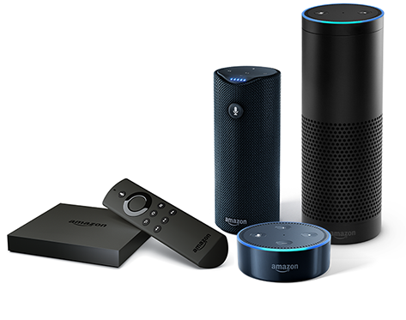
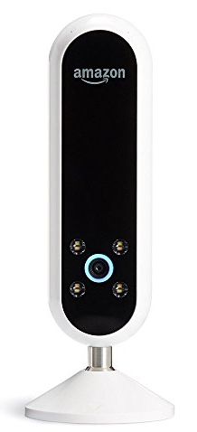
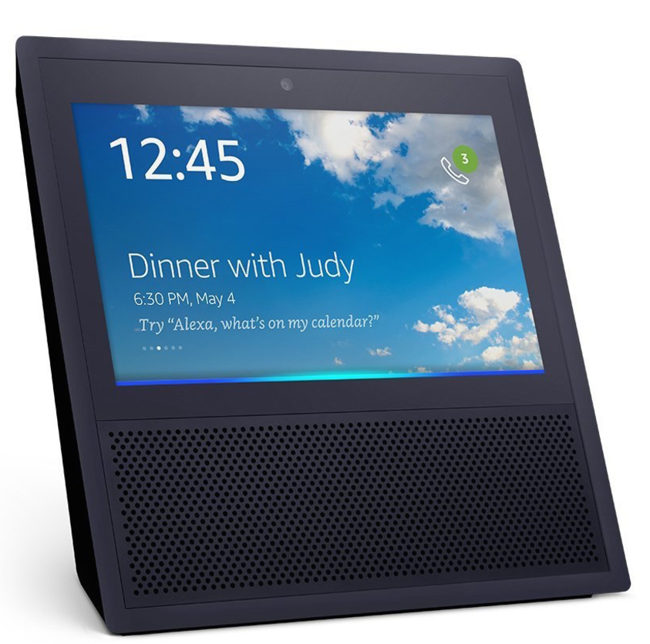
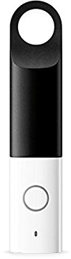
Devices that use alexa – the “Internet of Things”
Added in 2017:
Dash Wand
Echo Look
Echo Show

Slide 5
What are alexa skills?
Alexa has some built-in features (music, reminders, timers, calling other users, weather, facts, calendar integration, etc.)
Skills can be created by any person or company to add new capabilities to Alexa.
Anyone with a device that uses Alexa can enable and choose from thousands of skills

Slide 6
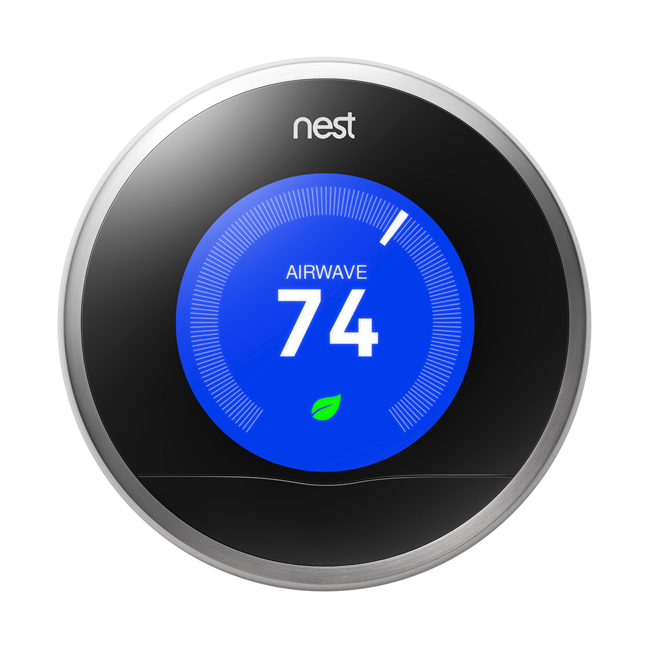



What can Alexa skills do?
Home Automation "Alexa, set the basement to 68 degrees“
News "Alexa, ask Washington Post for headlines”
Food Ordering
"Alexa, open Domino's and place my Easy Order“
Games
“Alexa, play Jeopardy”

Slide 7
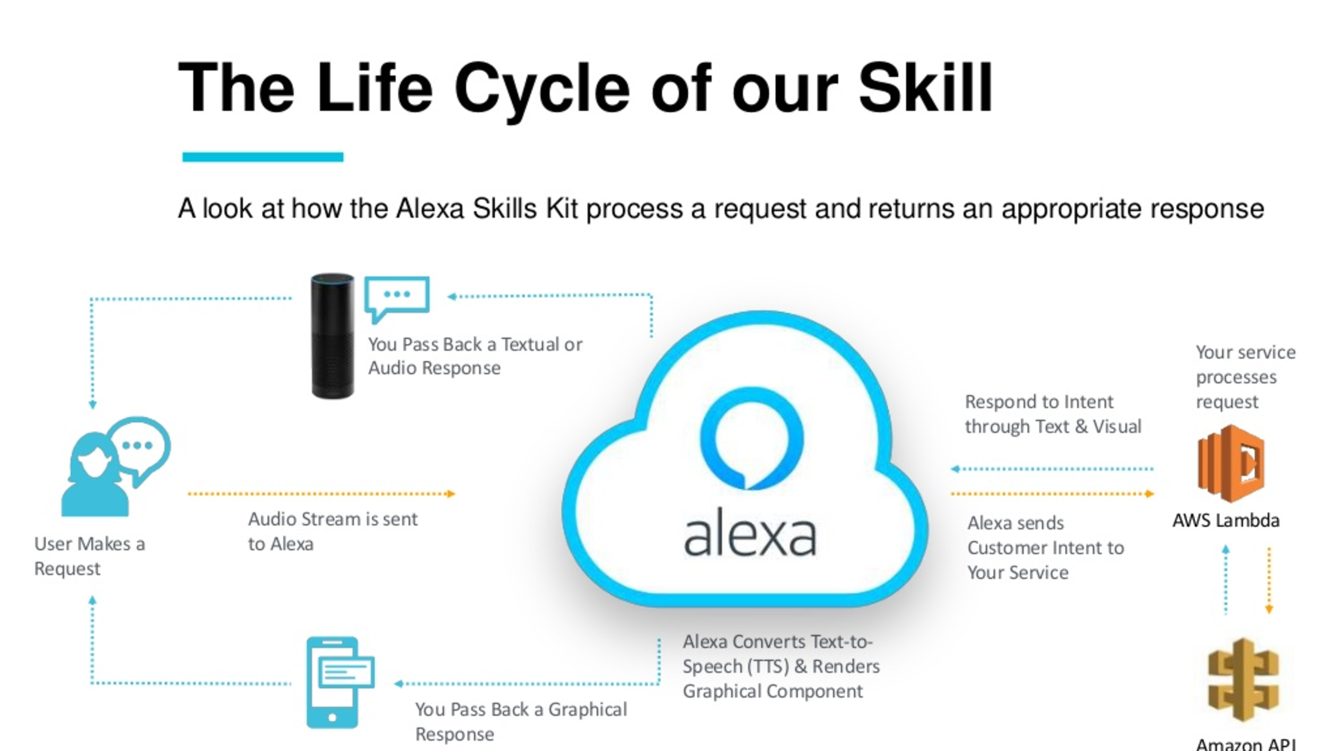

Slide 8
Open the sample code in github
https://github.com/full-steam-ahead/alexa

Slide 9
In another tab, Login to our demo Amazon developers account
https://developer.amazon.com
Username: alexa@techemstudios.com
Password: techme17

Slide 10
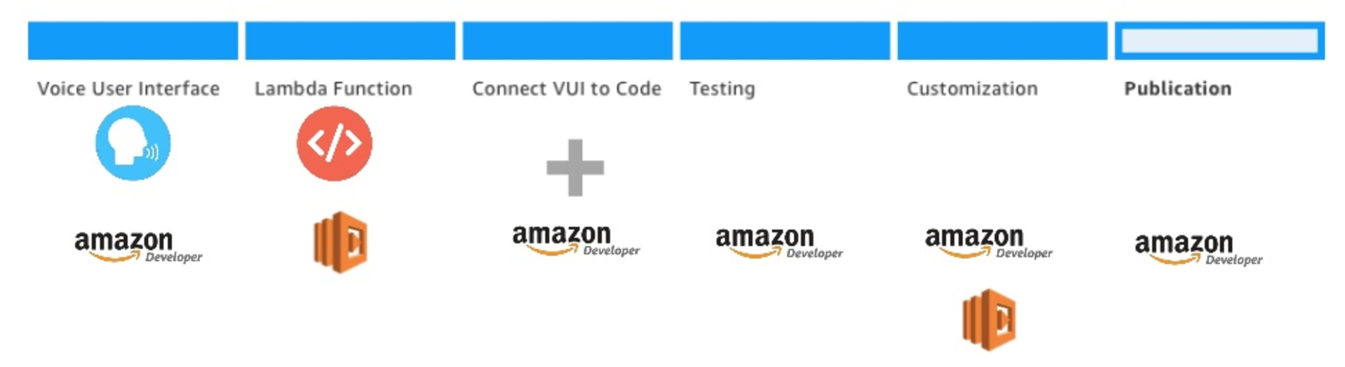
Step 1: Set up the voice user interface (VUI) using the Alexa Skills Kit (ASK)

Slide 11
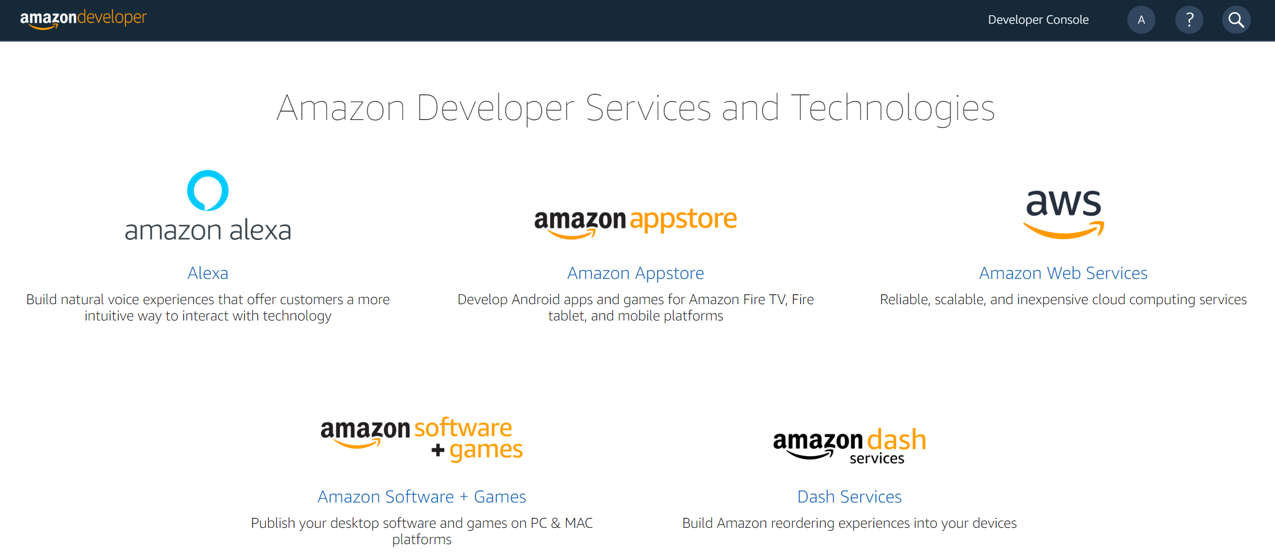

Slide 12
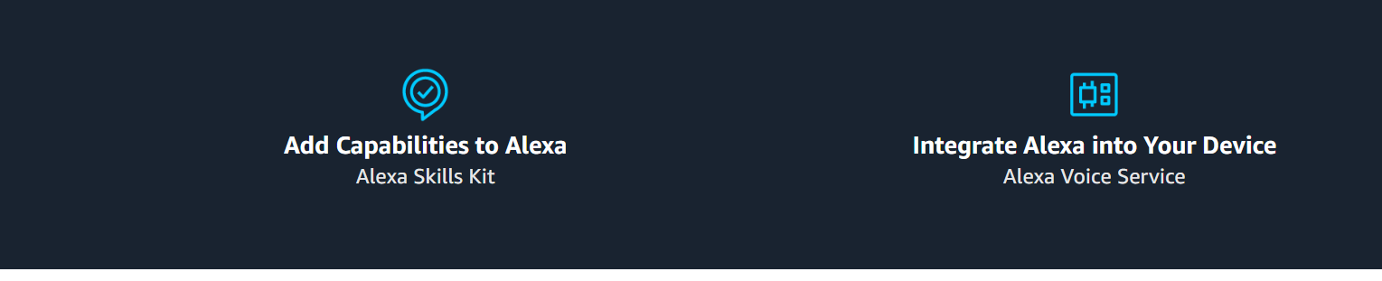
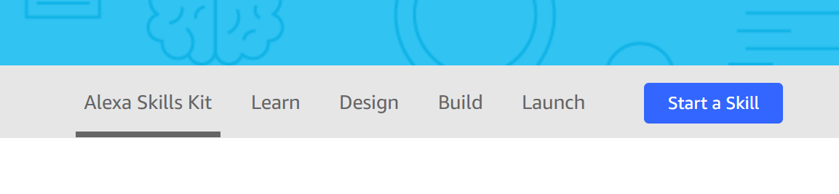
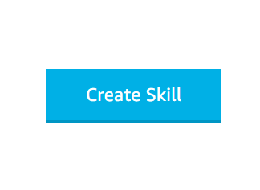

Slide 13
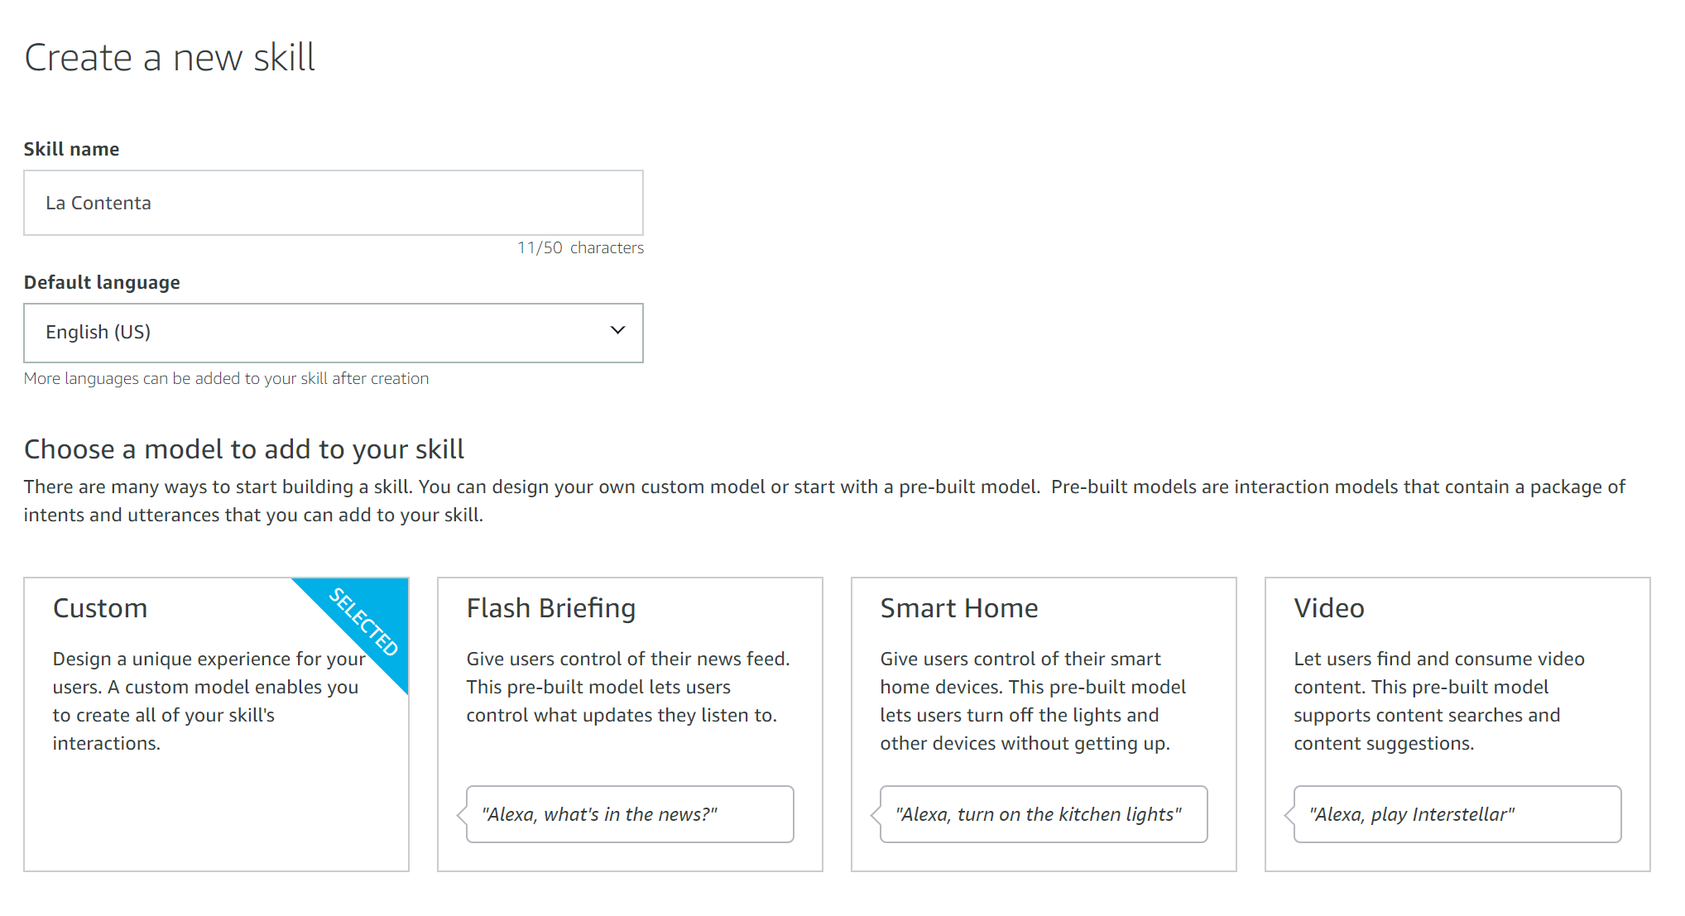

Slide 14
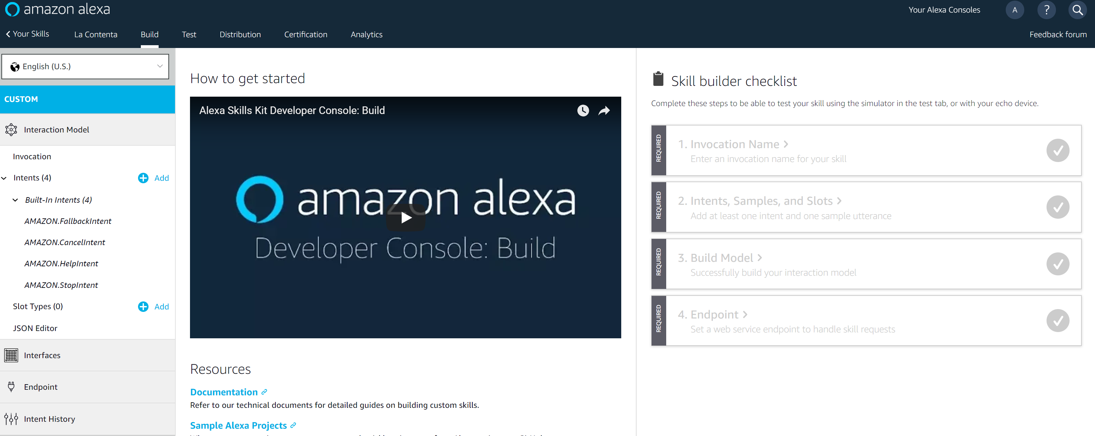

Slide 15
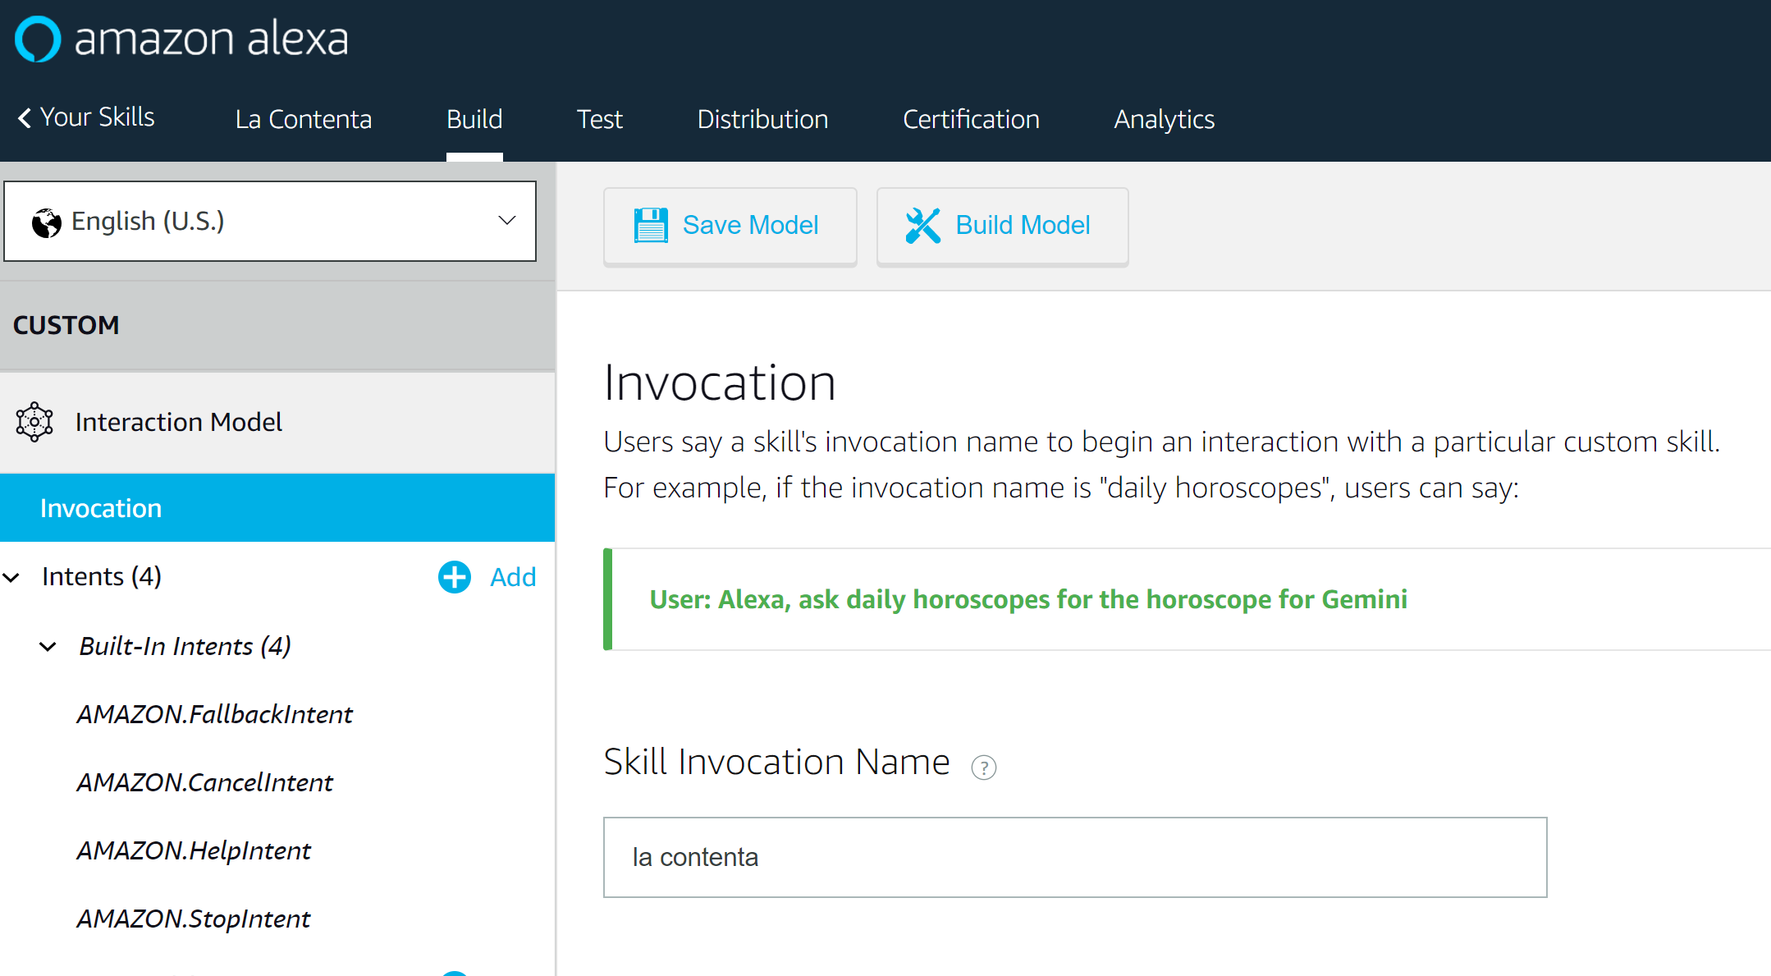

Slide 17
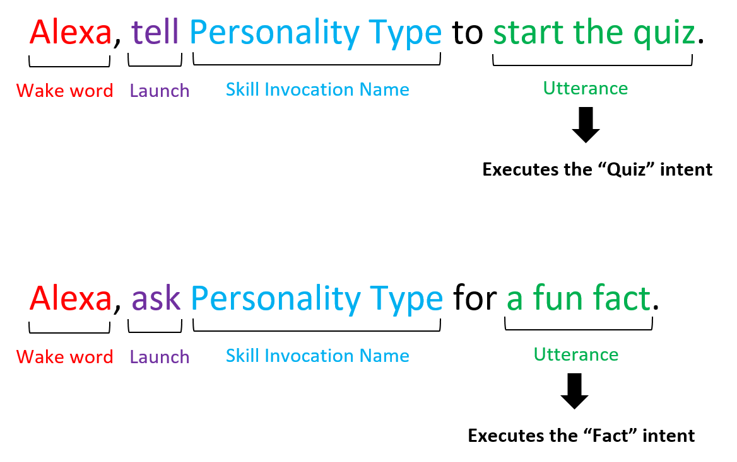
terminology

Slide 18
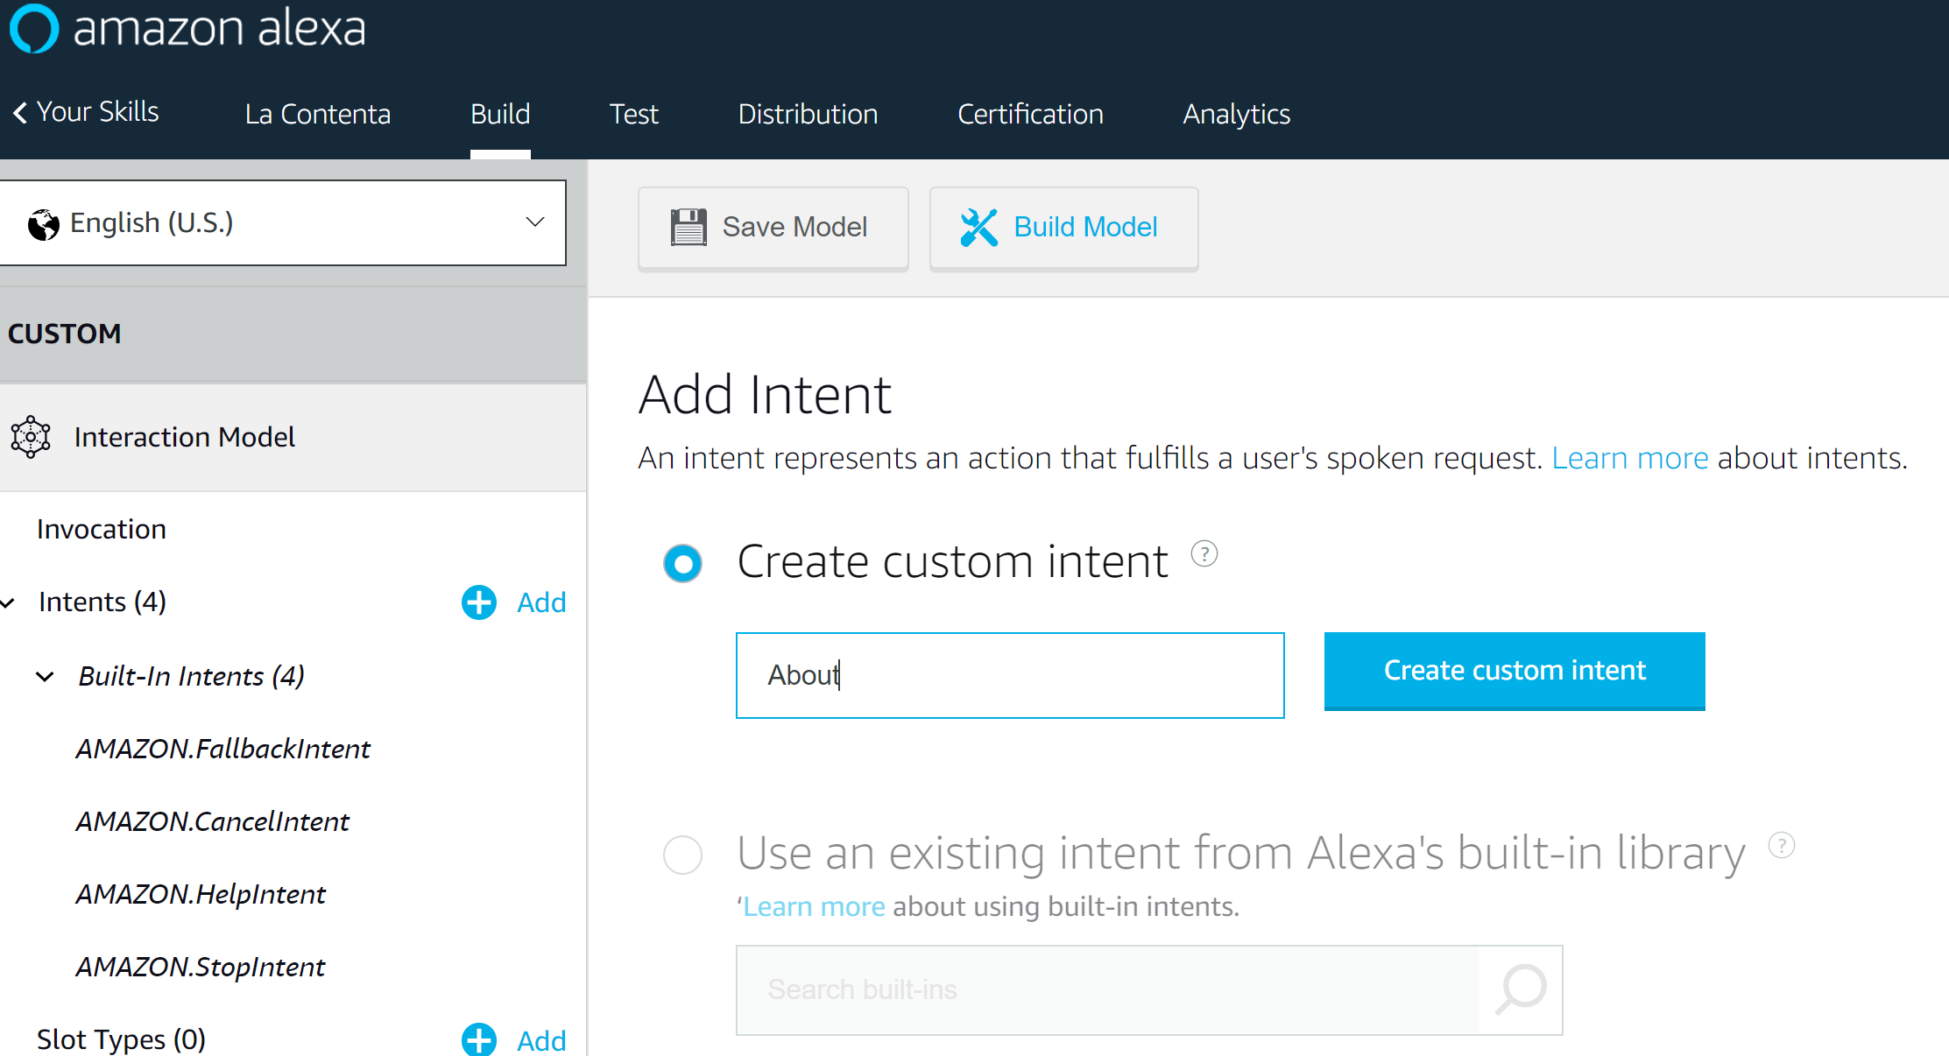

Slide 19
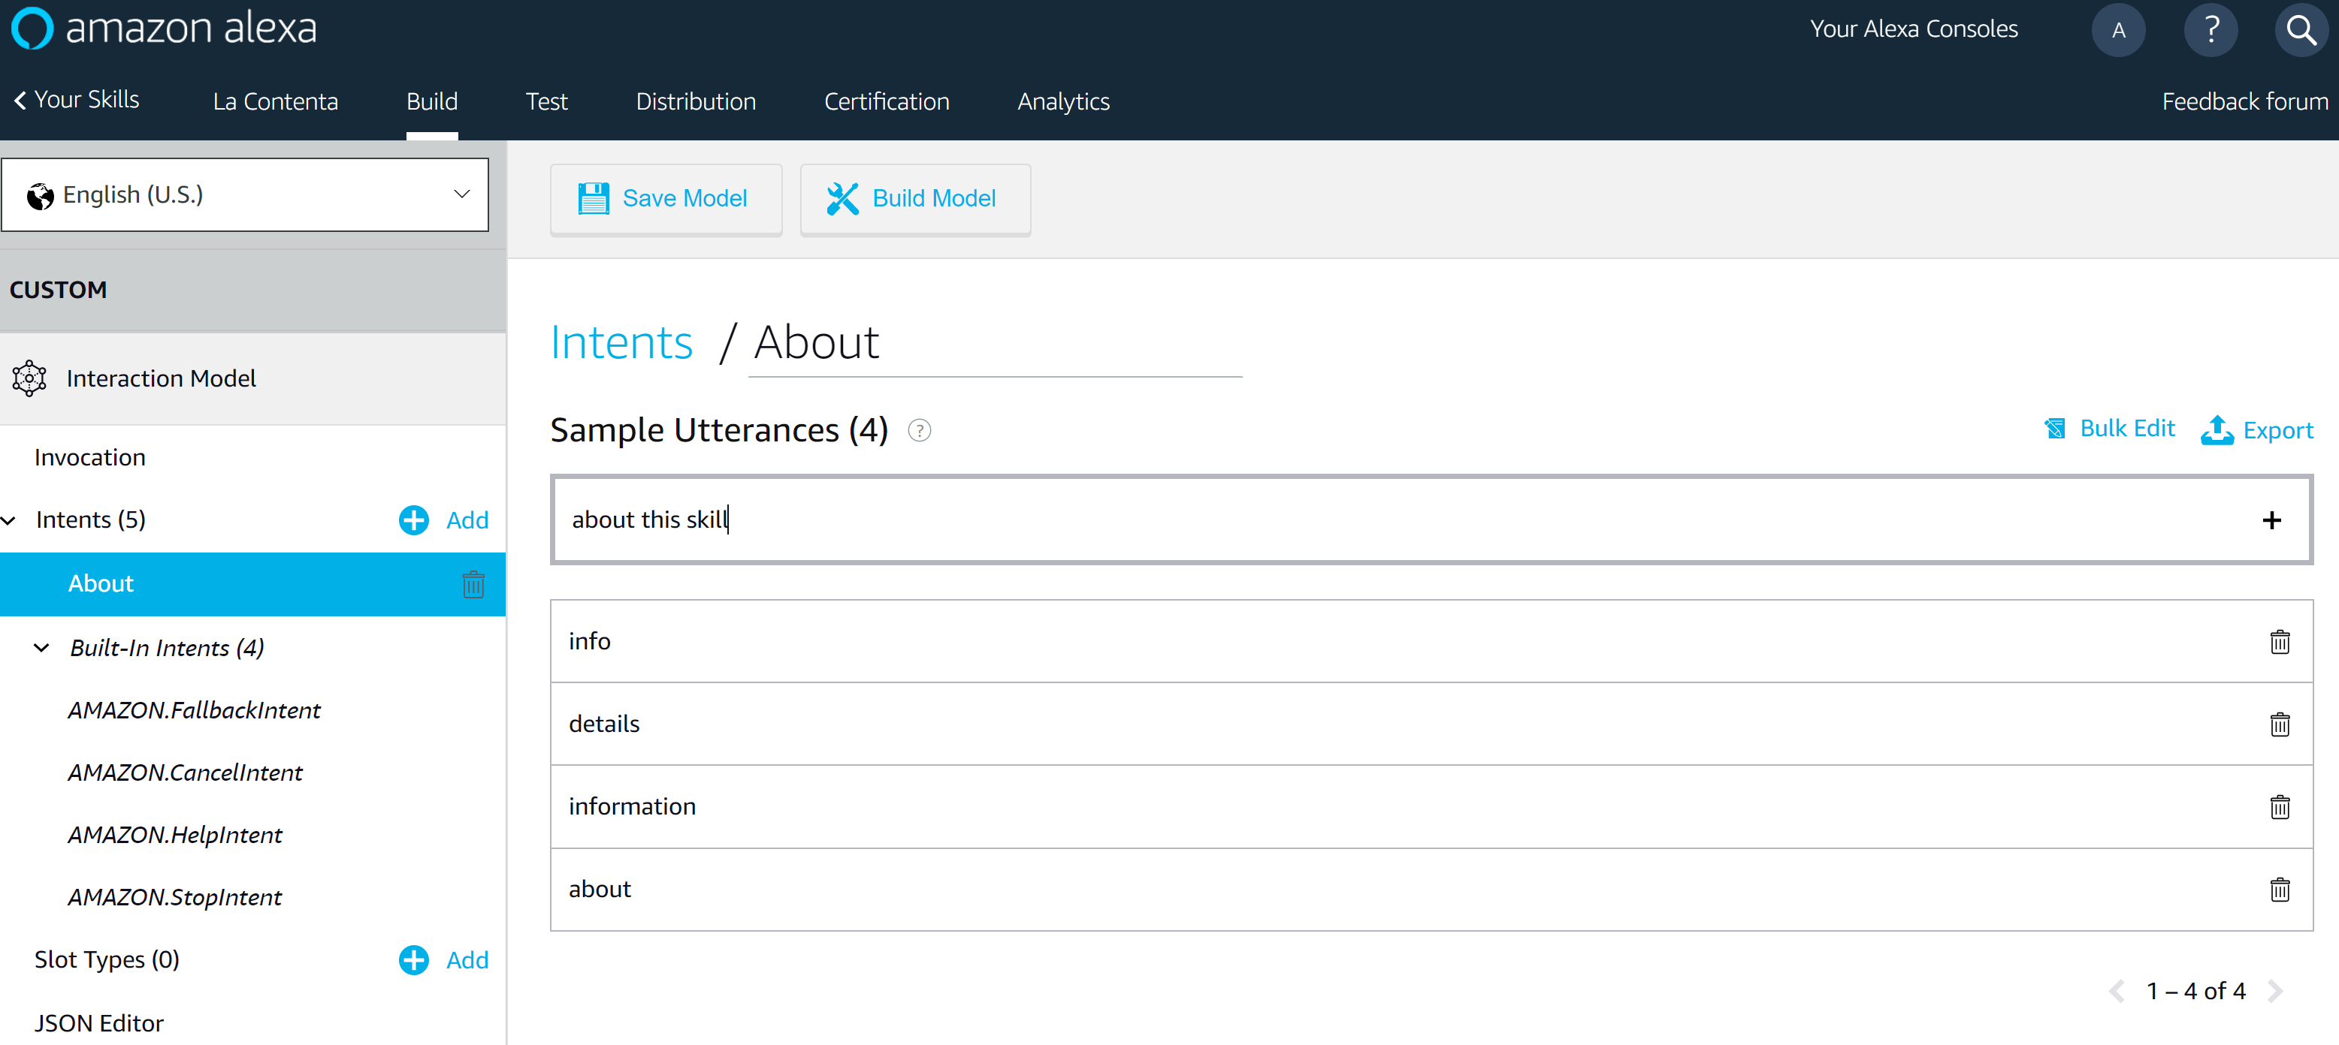

Slide 20
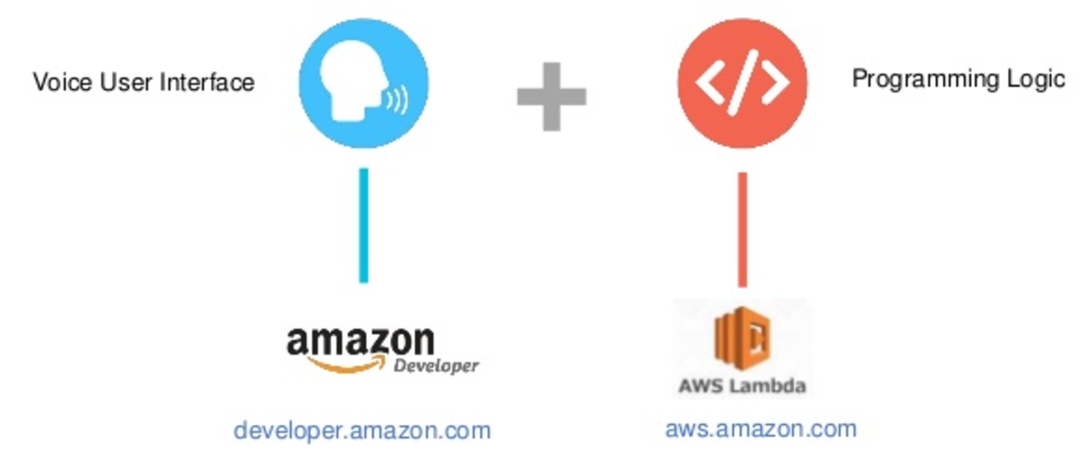
Components of an alexa skill

Slide 21
Step 2: create your skill logic using an AWS Lambda Function

Slide 22


What is the cloud?
The cloud is software and services that run on the internet (a.k.a someone else’s server) instead of from your computer.
Amazon Web Services (AWS) is a cloud services platform.
AWS Lambda is one of those services – it lets you build and run your code online.

Slide 23
In a new tab, Login to our demo AWS account
https://techem.signin.aws.amazon.com/console
Username: lambda@techemstudios.com
Password: techme17

Slide 24
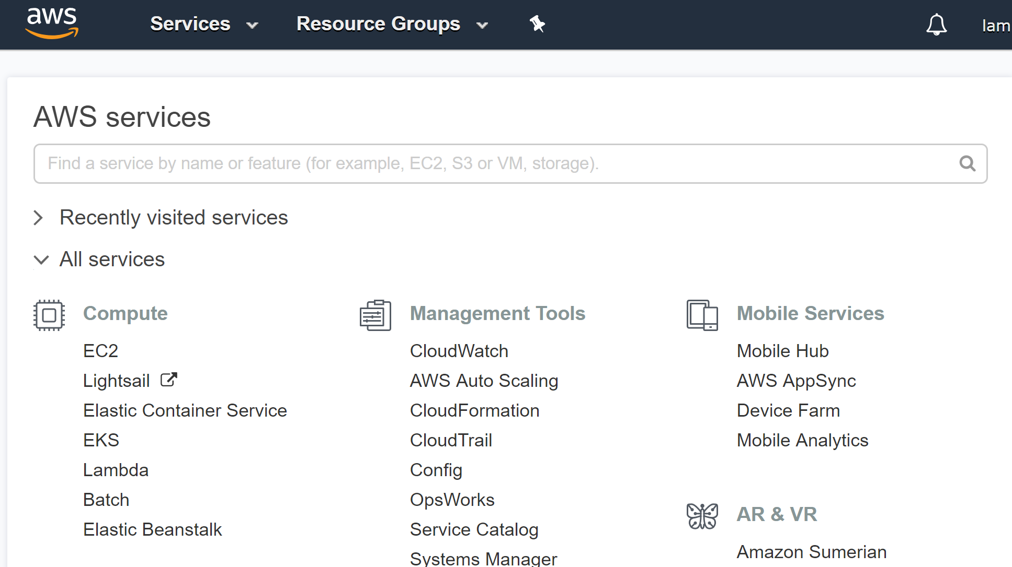

Slide 25
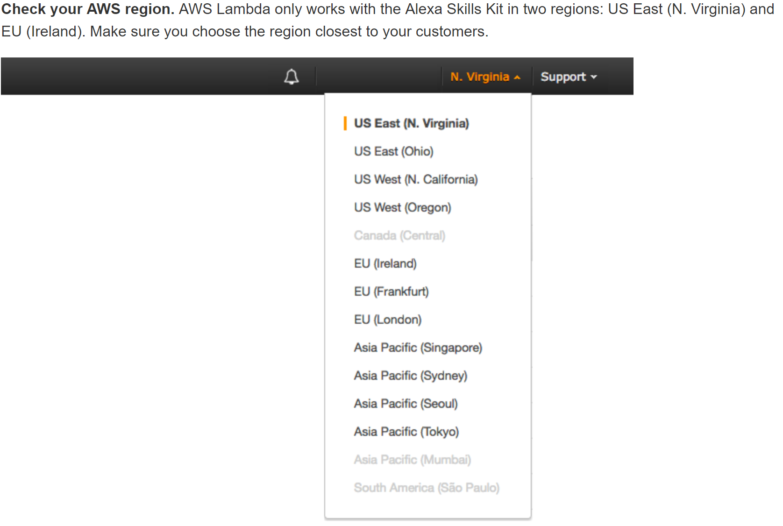

Slide 26
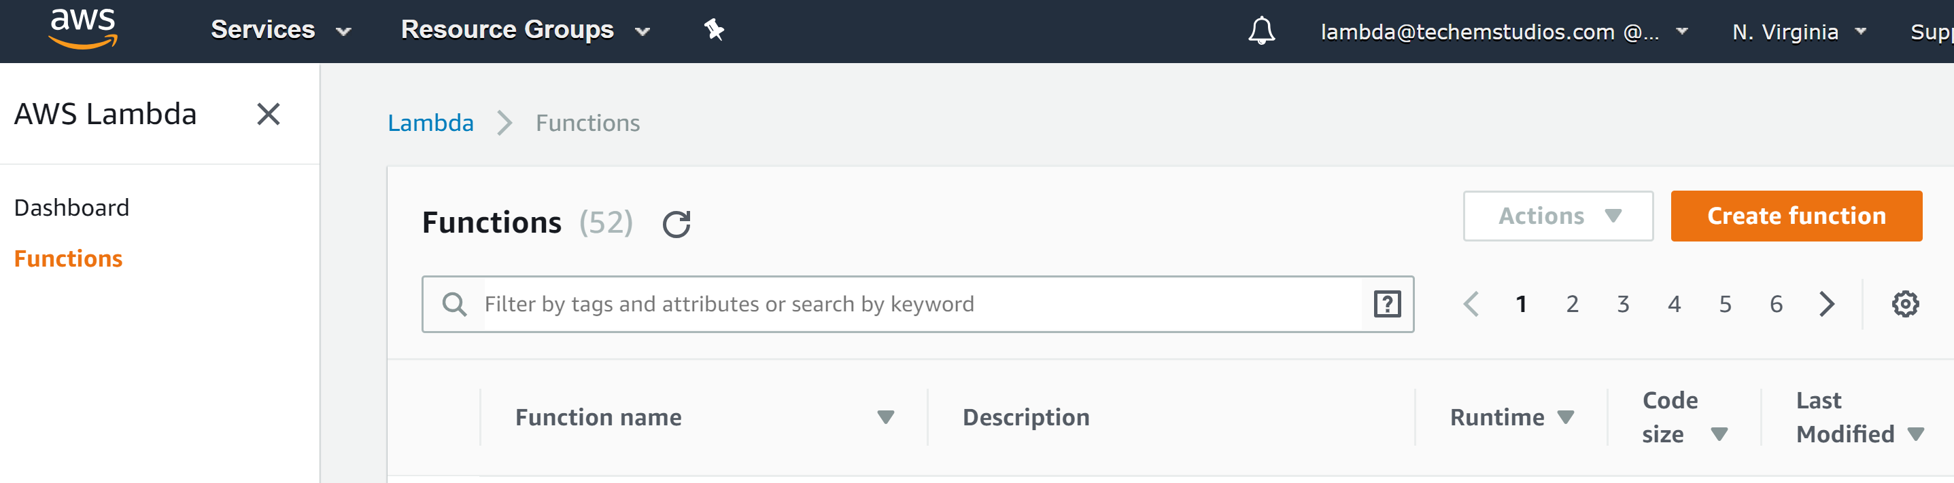

Slide 27
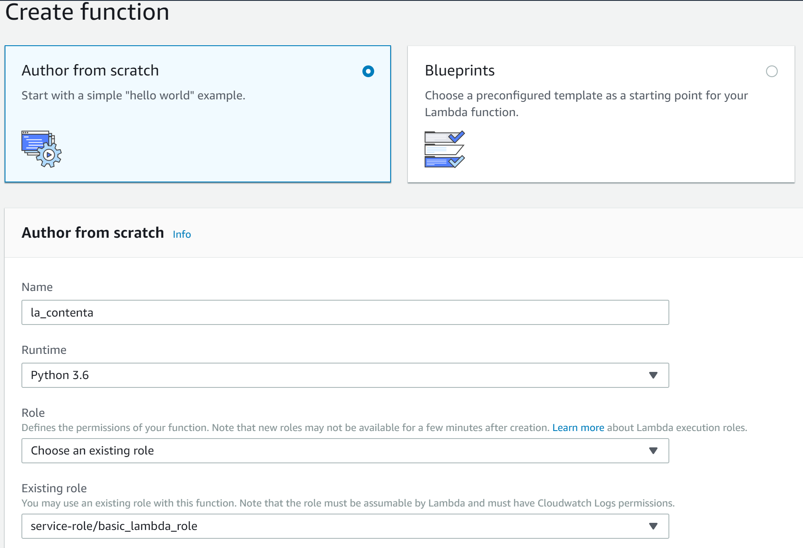


Slide 28
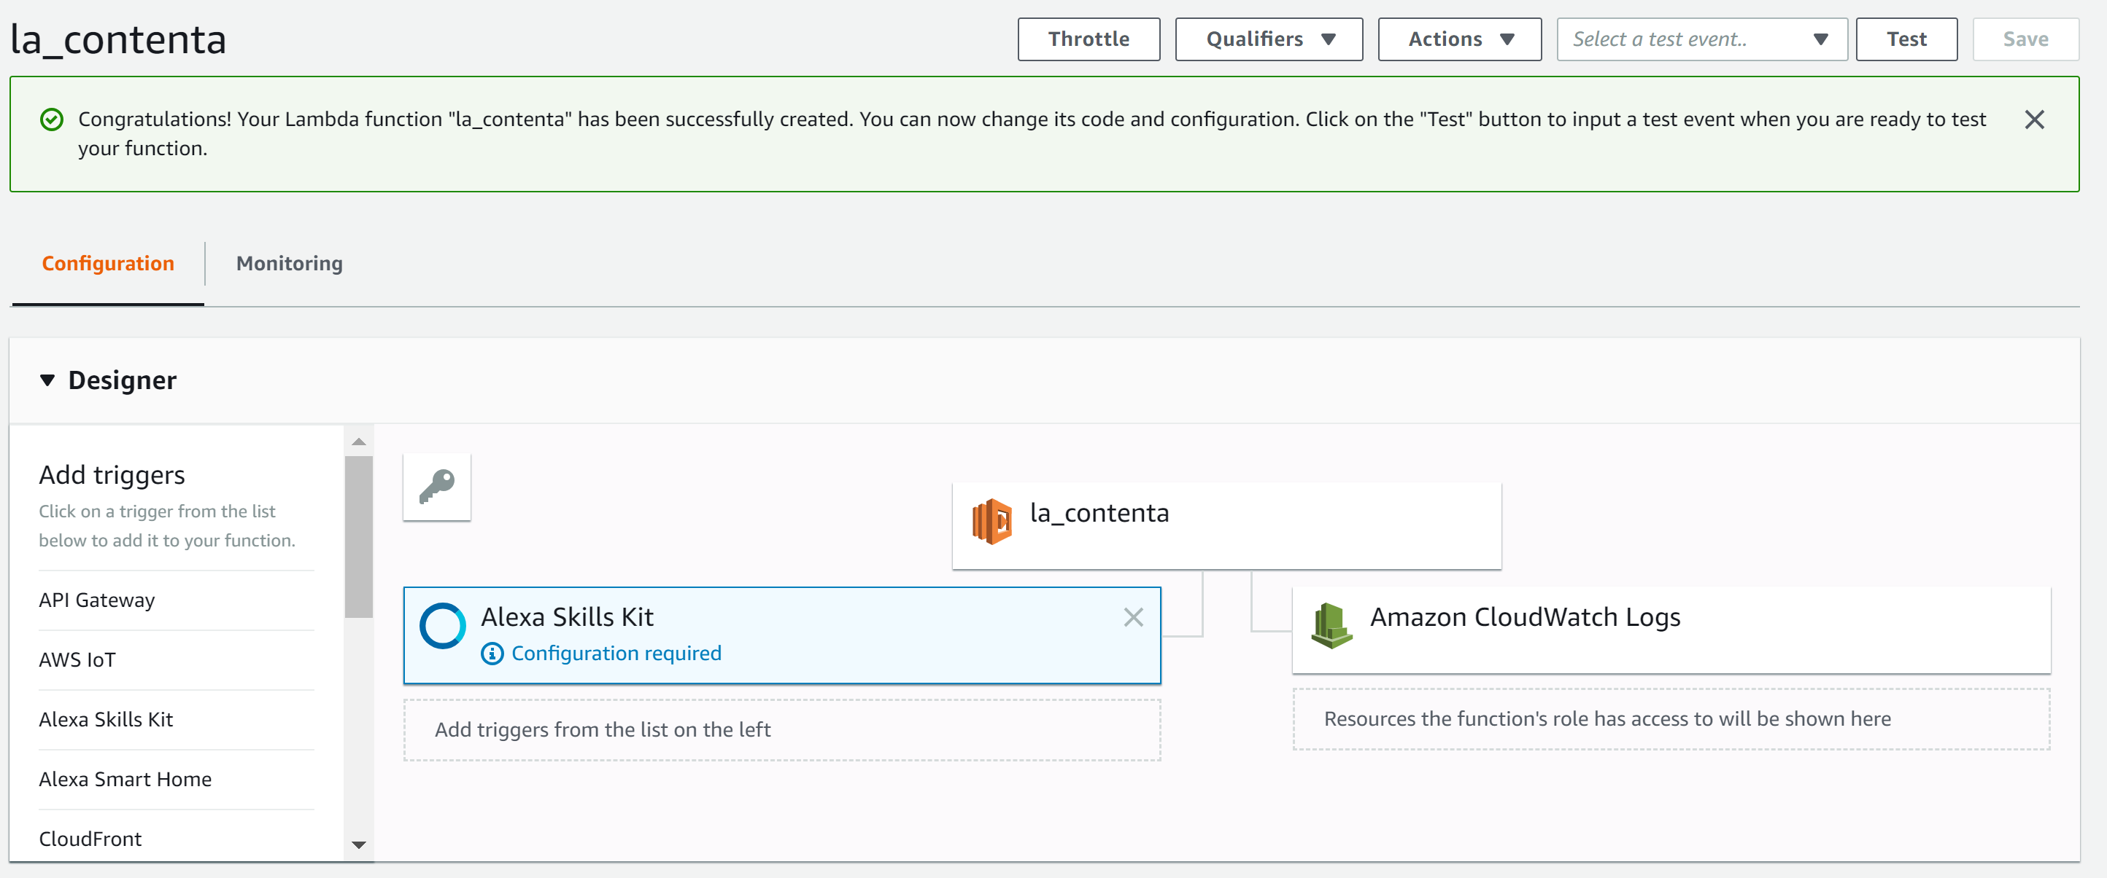

Slide 29
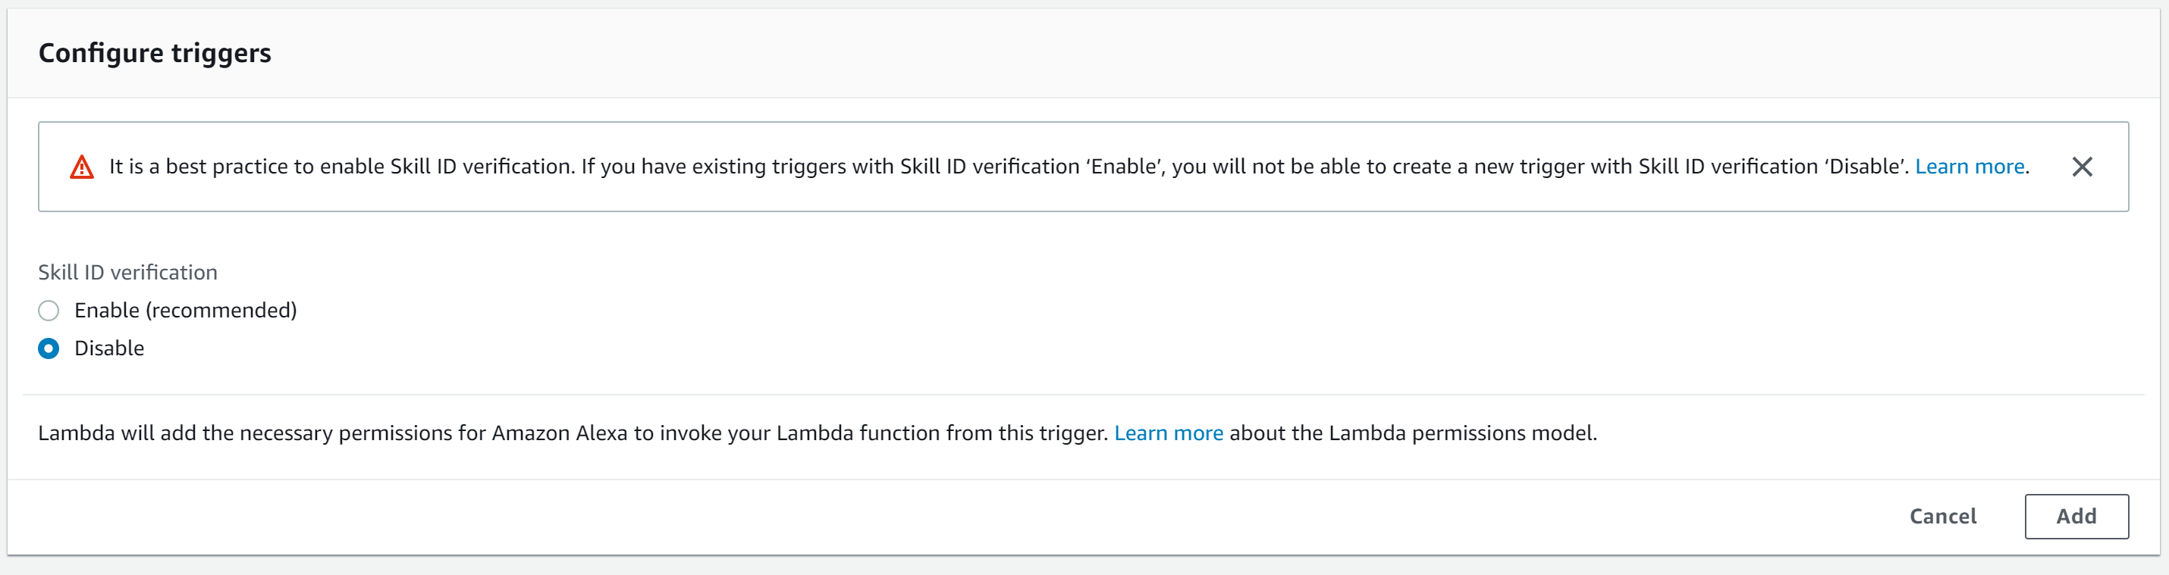

Slide 30
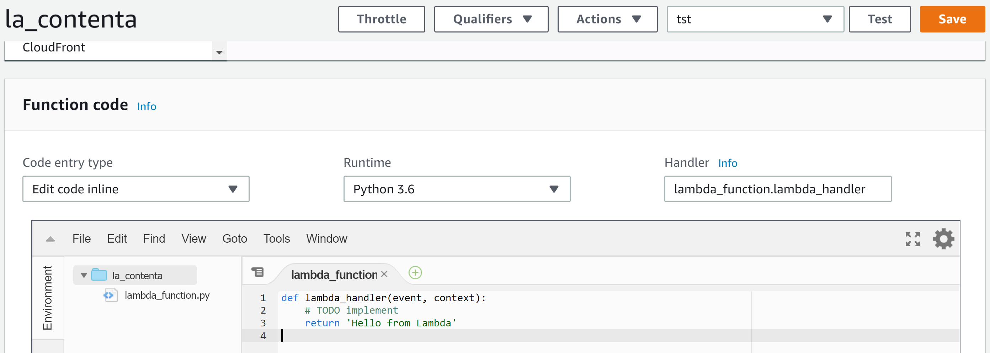
paste the lambda code from GitHub here

Slide 31
Step 3: Connect Your Voice User Interface To Your Lambda Function

Slide 32
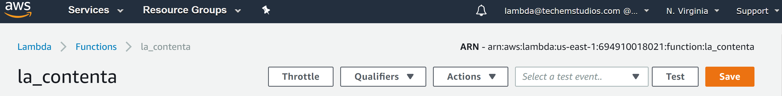

Slide 33
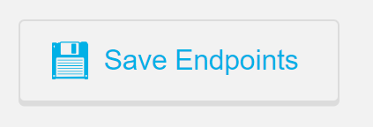
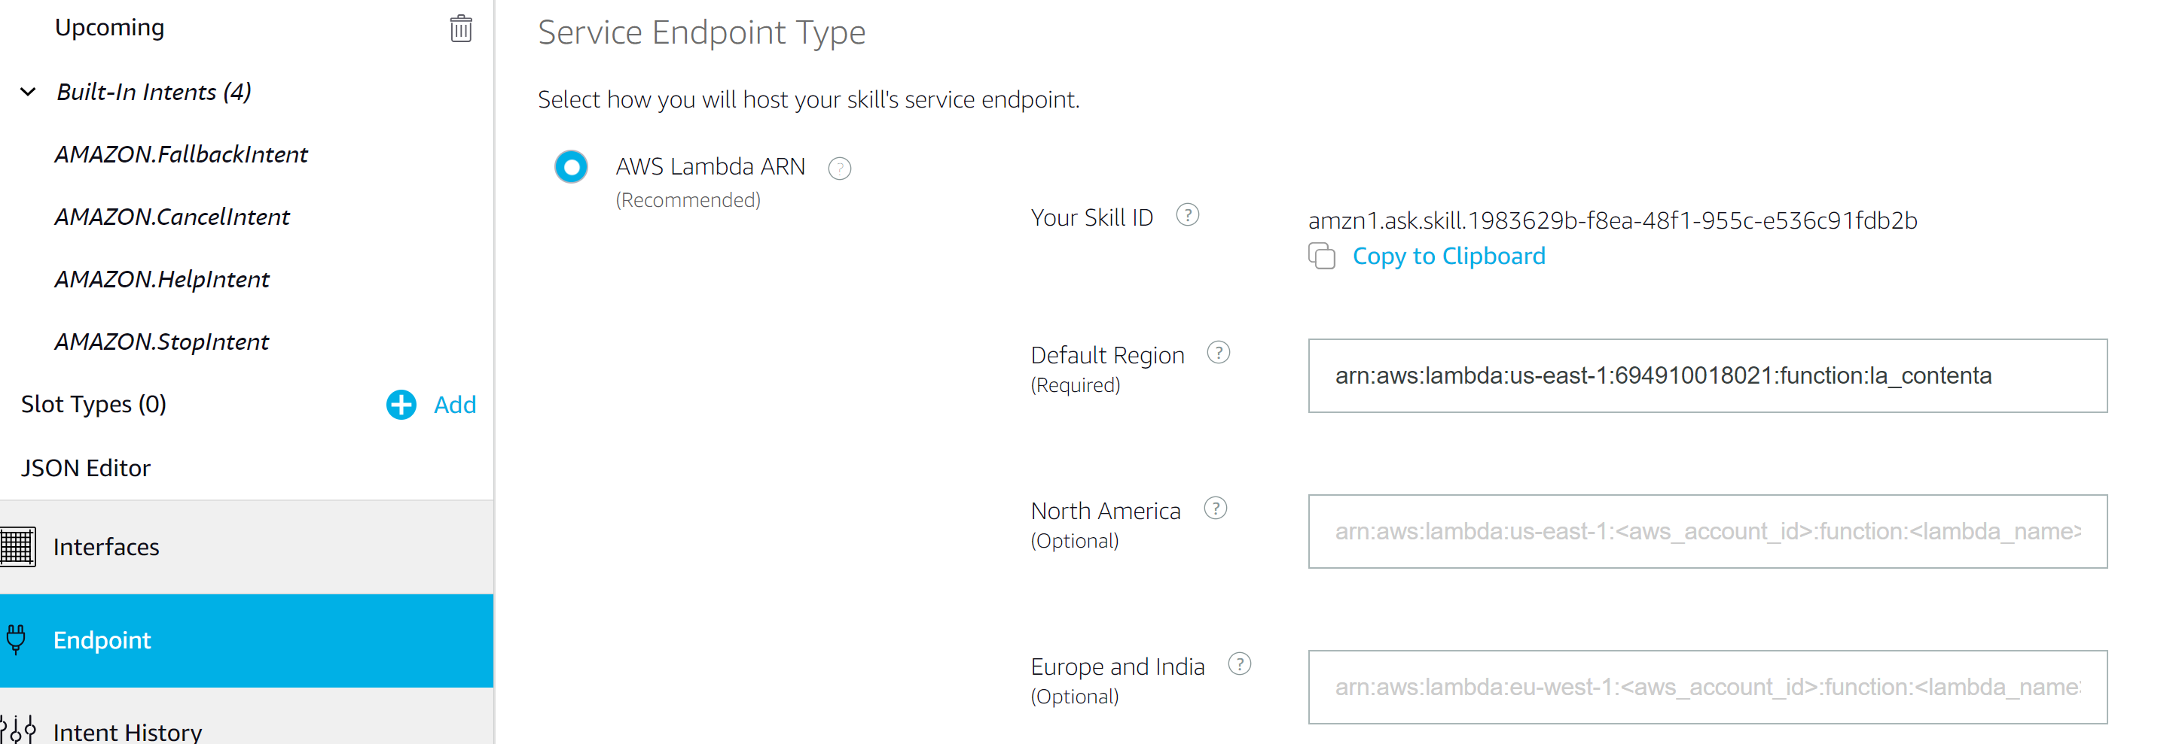

Slide 34
Step 4: Test the Alexa Skill

Slide 35
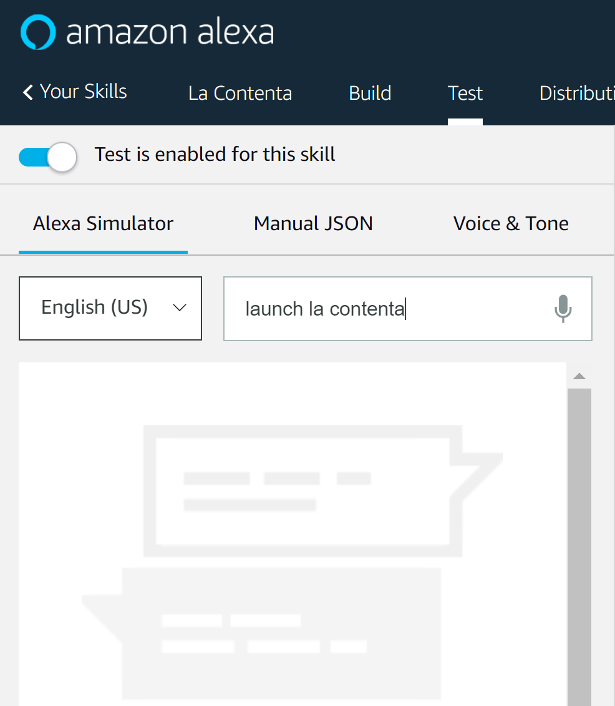
Note: To test intents, you have to include the skill’s invocation name (“la contenta” in this case) with the utterance (“launch” in this case).

Slide 36
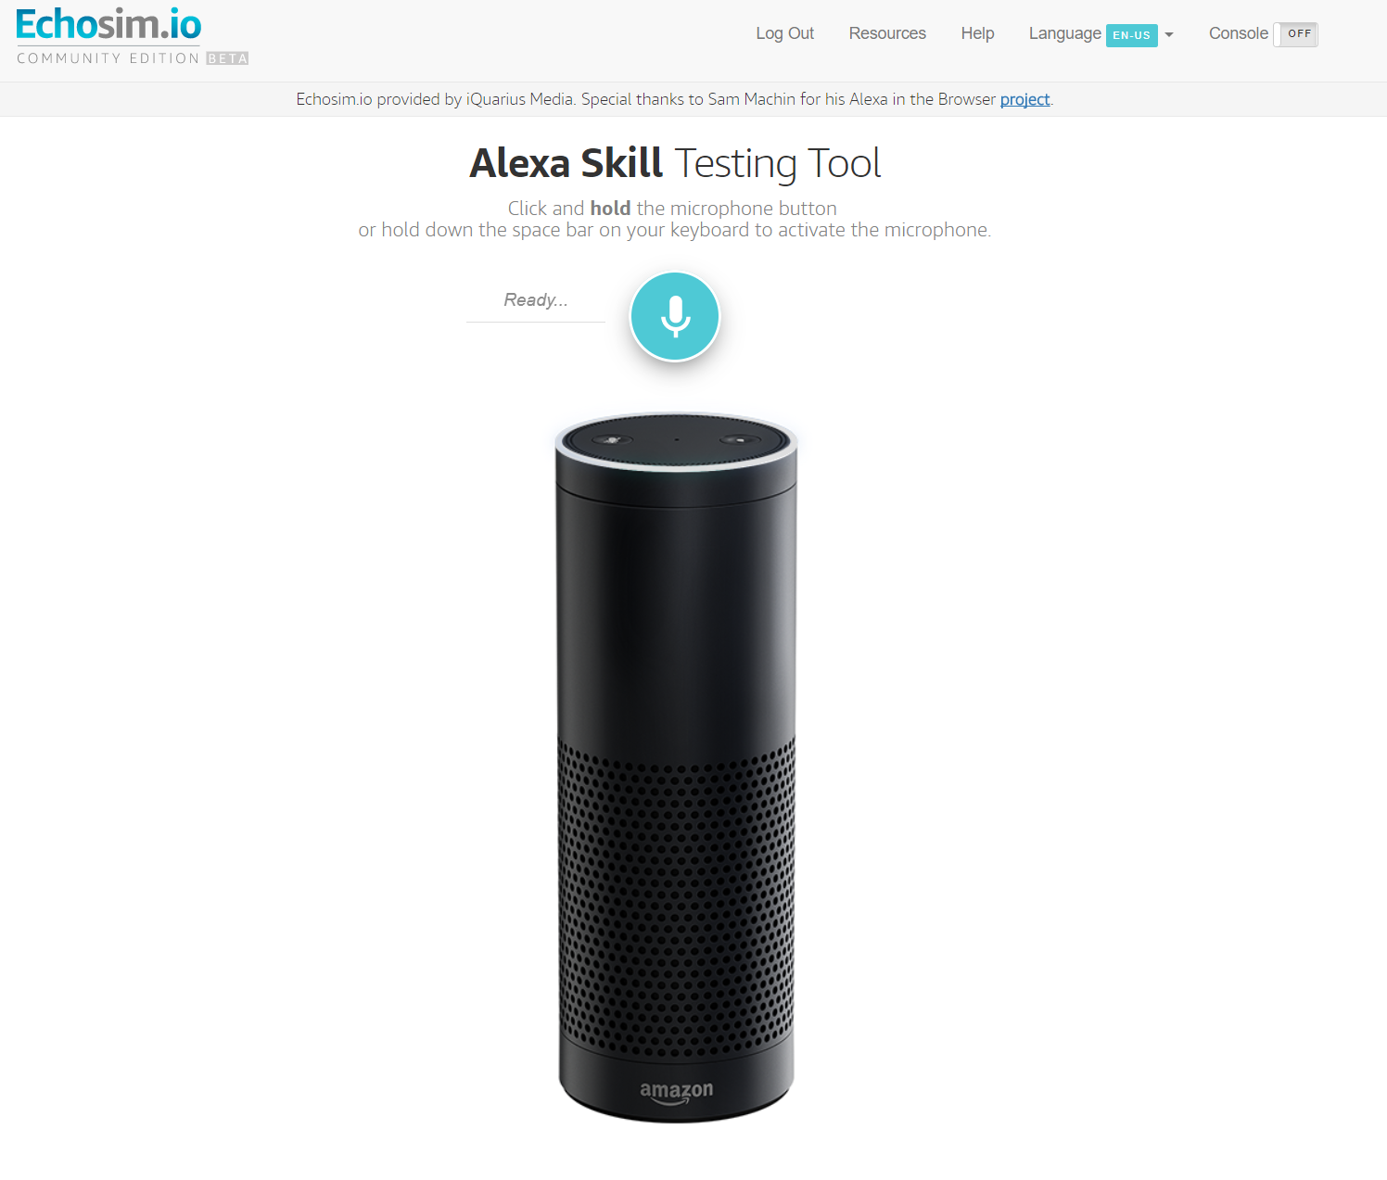
If you don’t have an Alexa-enabled device, you can perform verbal testing of your skill on Echosim.io instead

Slide 37
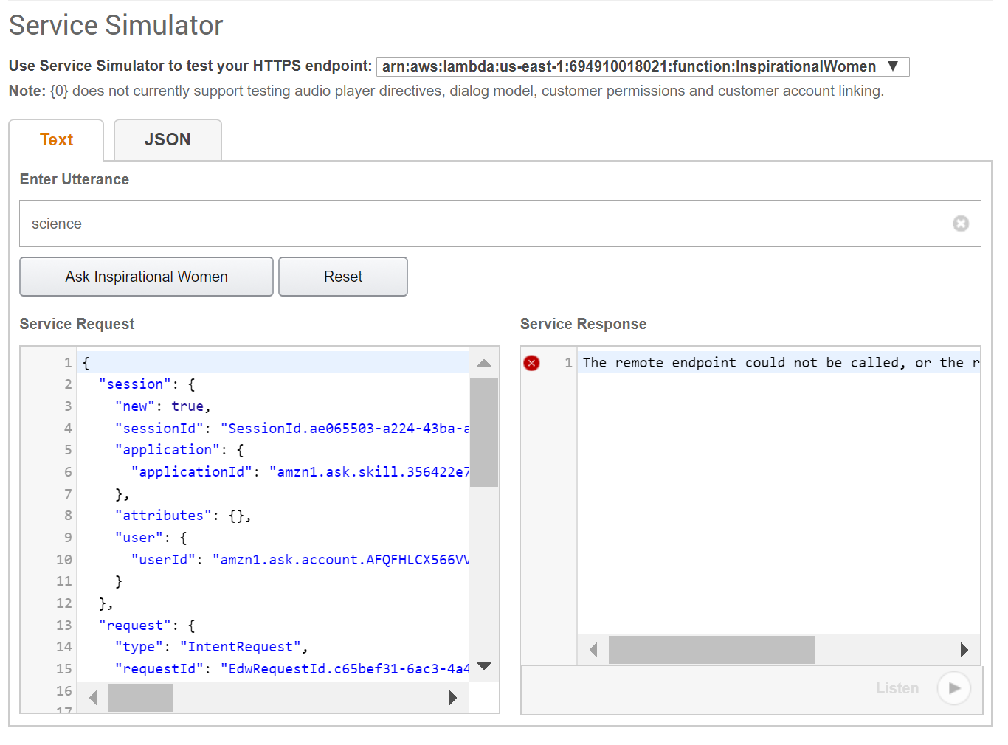
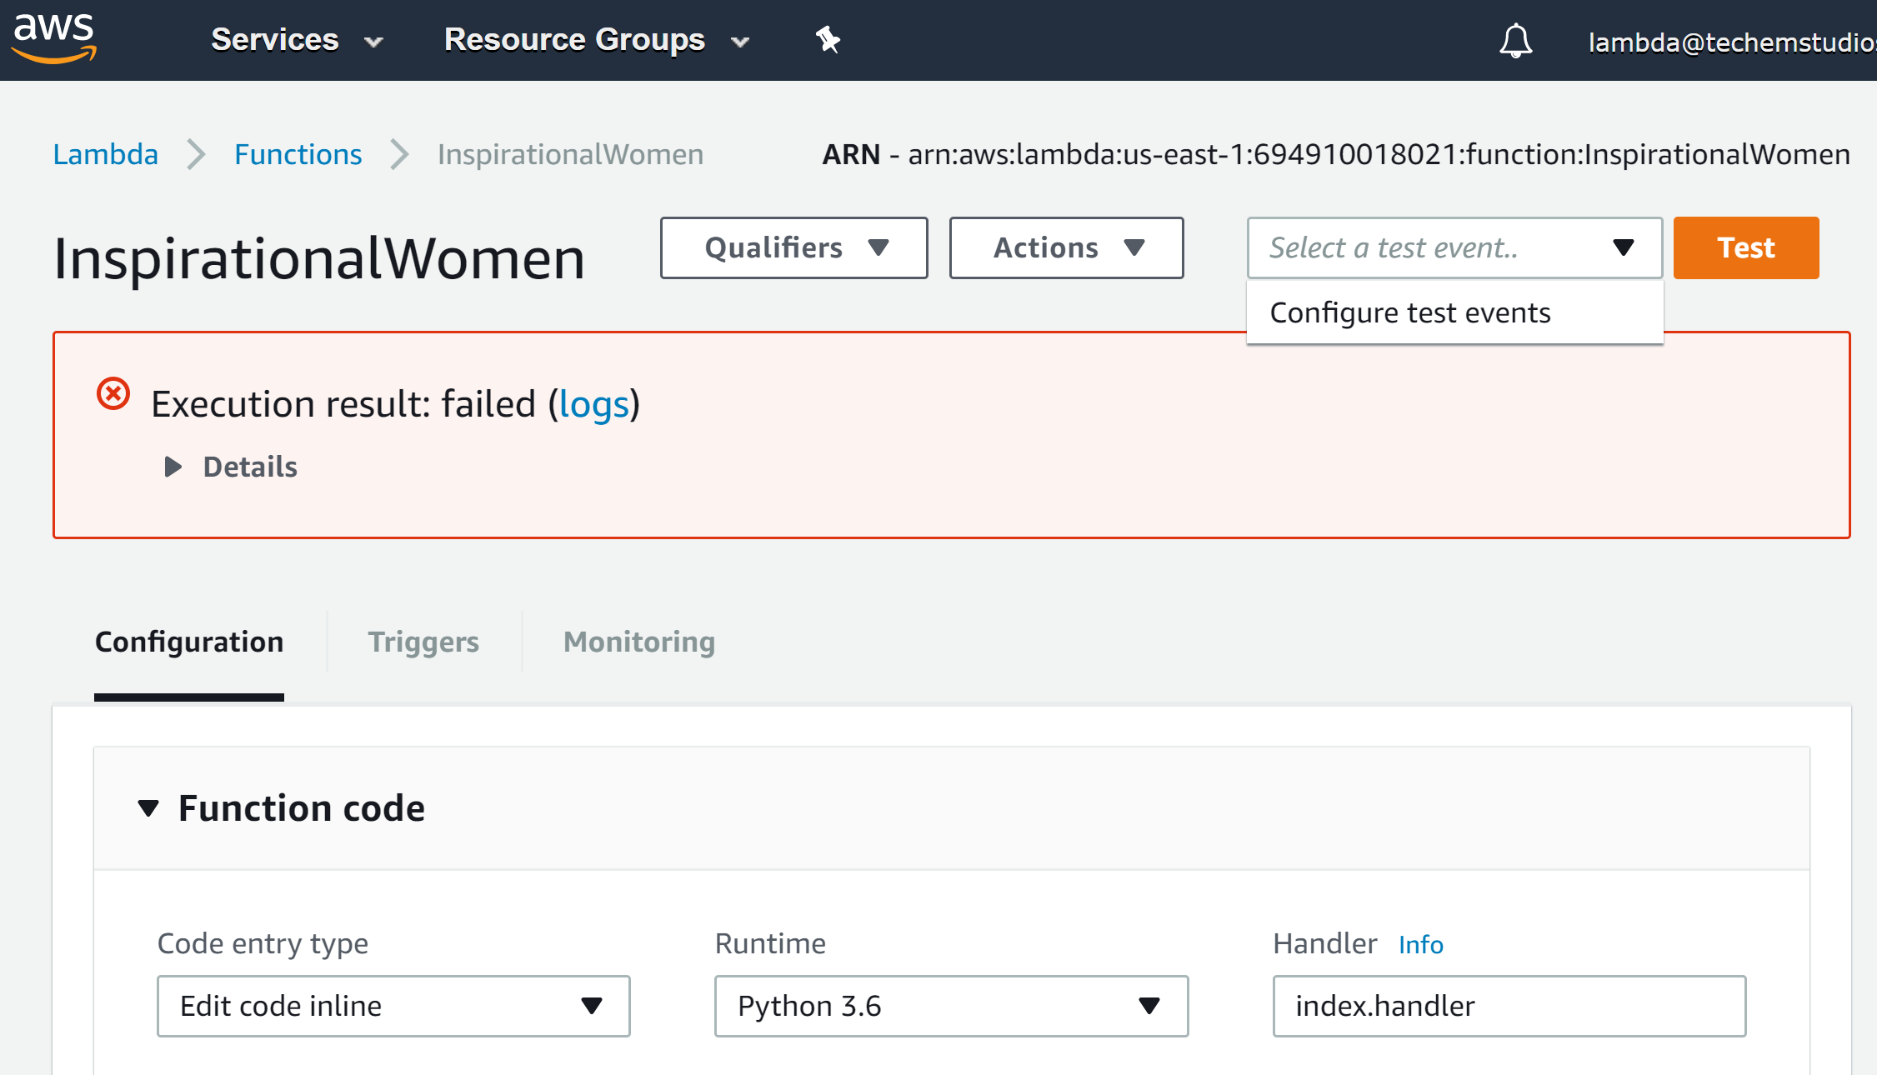
Troubleshoot Errors: Copy the service request from the Service Simulator and paste into the Lambda’s “Configure test events” modal. Then click “Test”. Error details will be under the Execution result’s Details section.

Slide 38
Step 5: Customize the Skill to be Yours

Slide 39
Step 6: optional - Get Your Skill Certified and Published

Slide 40
How to publish your skill
Publish your Alexa skill by following these instructions!
Amazon will either provide feedback OR publish the skill within 7 days of you submitting it for certification. It may take you several submissions to get your skill certified if it doesn’t meet all of Amazon’s requirements.
Every month, Amazon has been giving out free stuff (like Dots!) for anyone who publishes a skill! All you have to do is fill out this form once your skill has been published.

Slide 41
Go forth and develop!!
1) Sign up for an Amazon Developers account*.
2) Sign up for an AWS account*. When registering, select the Personal Account option. It will ask you for credit card information but will not charge your card if you’re using the account just to create basic Alexa skills. * If you already have an Amazon account, just sign in using your existing login.
3) For step-by-step tutorials on how to create skills including a facts skill, a trivia skill, and a quiz game skill, use Amazon’s Alexa Skills Kit Tutorials.

